Slide 1

CMOS Inverter
by Megan Izzo

Slide 2
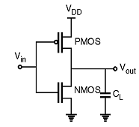
Function of the CMOS Inverter
CMOS - Complementary-Symmetry Metal–Oxide–Semiconductor.
FET - Field Effective Transistor.
Splits electrons using the oxygen layer.
Internal structure is a combination of PMOS and NMOS transistors.
Low voltage leads to high logic.
High voltage leads to low logic.
Notes:
CMOS stands for Complementary Symmetry Metal Oxide Semiconductor. It is called this because it is created with a metal gate that rests upon the top of the oxygen’s insulating layer, which is on top of a semiconductor. CMOS is a FET transistor, meaning that the current output is affected/controlled by an electric field. However, there is one difference that a CMOS does, that regular FETs don’t do. The oxygen layer splits electrons inside the gate and semiconductor part. The structure of CMOS is a combination of PMOS and NMOS transistors. PMOS is structured in the top half, while NMOS is in the bottom half. When the input voltage is low, the PMOS is turned on, while NMOS is turned off, which then results in high logic output voltage. In like manner, when the input voltage is high, PMOS is switched off, while NMOS is switched on, which yields low logic output voltage.

Slide 3
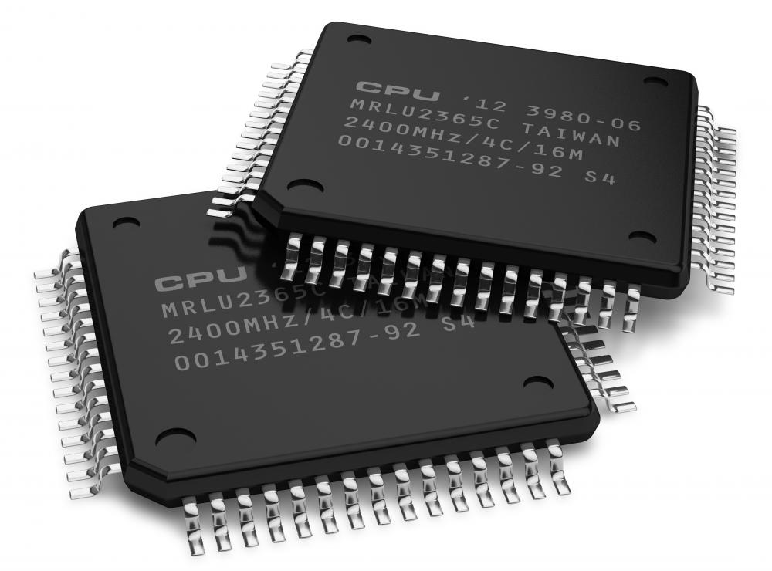
What is it used for?
What CMOS Inverters do:
Logic using devices
Uses binary to determine logic output voltage
What CMOS Inverters are used for:
Integrated Circuits (ICs)
Many day to day electronics
Notes:
CMOS Inverters are prevalent in many electronic devices that are used today. CMOS Inverters are used to provide the logic function for any device that needs it to properly work. The voltage output for logic is determined using binary. If the input logic is zero, then the output would be one, which is high. Similarly, if the input logic is one, then the output will be zero, which, as you can guess, is low. CMOS Inverters are used in integrated circuits, such as microprocessors, microcontrollers, static RAM, data converters, transceivers, and image sensors. CMOS Inverters can be found in many electronic devices that are used in this day and age. A list of these devices that use CMOS Inverters are as follows: mobile phones, tablets, digital cameras, computers, laptops, routers, modems, network servers, video gaming devices, smart speakers, little personal robots (i.e. Cosmo, Vector), high grade calculators, and smart watches.

Slide 4
Advantages of CMOS Inverter
Cheap to mass produce
Has high noise immunity
Doesn’t use too much power
Low waste heat
Characteristics of an ideal inverter
Small steady-state power dissipation
Notes:
CMOS Inverters have many advantages. First is that mass producing CMOS Inverters is cheap which is great since they are used in many devices. CMOS Inverters also have a high noise immunity, which means that they can block out frequency spikes that can be produced from both ingoing and outgoing sources. CMOS Inverters are known for not using up too much power. They only use power when they are turned on and off. Since CMOS Inverters use less electricity, they also produce less or little waste heat. This makes them ideal to be used in small electronics. The CMOS Inverter expresses ideal inverter characteristics by having sharp voltage transfer characteristics and having a complete output voltage pivot between 0V and the power supply voltage. CMOS Inverters also have a steady-state power dissipation that is incredibly small and insignificant, it can be easily looked over and not seen at first glance.

Slide 5
Disadvantages of CMOS Inverter
Switching speed is high
Hard to manufacture
Takes up more space on the ICs
Notes:
Surprisingly enough, there aren’t many disadvantages to using a CMOS Inverter. For one, the switching speed to toggle the logic output from or to high and low, depending on the changed logic input, is high. Which means that even though having a high switching speed is nice to have to minimize power dissipation, it can cause electromagnetic interference. Although mass producing CMOS Inverters is cheap, they are also hard to manufacture due to both the PMOS and NMOS transistors being on the same Silica piece. Another disadvantage of the CMOS Inverters is that they take up more space on the integrated circuits since the CMOS Inverter is made up of the PMOS and the NMOS transistors.

Slide 6
Variations of CMOS Inverter
Standard
TC4000B/TC4500B
High-Speed
TC74HC
TC74HCT
Advanced
TC74AC
TC74ACT
Very-Low-Voltage
TC74VCX
Very-High-Speed
TC74VHC
74VHC
TC74VHC9
74VHC9
TC74VHCT
74VHCT
TC74VHCV
74VHCV
Low-Voltage
TC74LCX
74LCX
Notes:
The CMOS Inverter comes in quite a few different variations due to the logic that is used in each variation. Starting with standard, it is, well, the standard CMOS that everyone has come to know and love. It was the first to start being produced in the late 1970’s. It has an operating voltage range of 3 to 18 volts. The high-speed CMOS Inverted started being made and used in the late 1980’s. This variation has two different operating voltage ranges because it can come in two different parts. The first part is TC74HC. This part has an operating voltage range of 2 to 6 volts. The second part for the high speed variation is TC74HCT. This has an operating voltage range of 4.5 to 5.5 volts. The Advanced CMOS began production and use in the early 1990’s. This variation also has two different parts with varying operating power ranges. The first one is TC74AC. This has an operating power range of 2 to 5.5 volts. The second is TC74ACT, which has an operating power range of 4.5 to 5.5 volts. The Very HIgh Speed CMOS Inverter has many different parts, but only three different operating power ranges between them all. The very high speed CMOS Inverter started being produced in the early 1990’s. The first four in the list have the same operating power range of 2 to 5.5 volts. Five and six in the list have an operating power of 4.5 to 5.5 volts. The last two operate with a power of 1.8 to 5.5 volts. The low voltage CMOS Inverter came around in the mid 1990’s. The low voltage and the very low voltage variations were created and are used for low voltage systems, while the other variations were created and used for 5V systems. The low voltage has an operating voltage range of 1.65 to 3.6 volts. The very low voltage has an operating power range of 1.12 to 3.6 volts.

Slide 7
References
Agarwal, T. (2022, January 28). CMOS Inverter : Circuit, Working, Characteristics & Its Applications. ElProCus - Electronic Projects for Engineering Students. https://www.elprocus.com/cmos-inverter/
Toshiba. (n.d.). Classification of CMOS Logic ICs and Overview of Each Series. Toshiba.semicon-Storage.com. Retrieved February 11, 2024, from https://toshiba.semicon-storage.com/ap-en/semiconductor/knowledge/e-learning/cmos-logic-basics/chap1/chap1-6.html

